Slide 1
Accountability & Research
ScWk 240 – Week 15 Slides

Slide 2
Empirically Based Practice
A type of intervention in which the professional social worker uses research as a practice and problem solving tool; collects data systematically to monitor the intervention; specifies problems, techniques, and outcomes in measurable terms; and systematically evaluates the effectiveness of the intervention used.
The Social Work Dictionary
Robert Barker, DSW, ACSW
NASW Press 1999

Slide 3
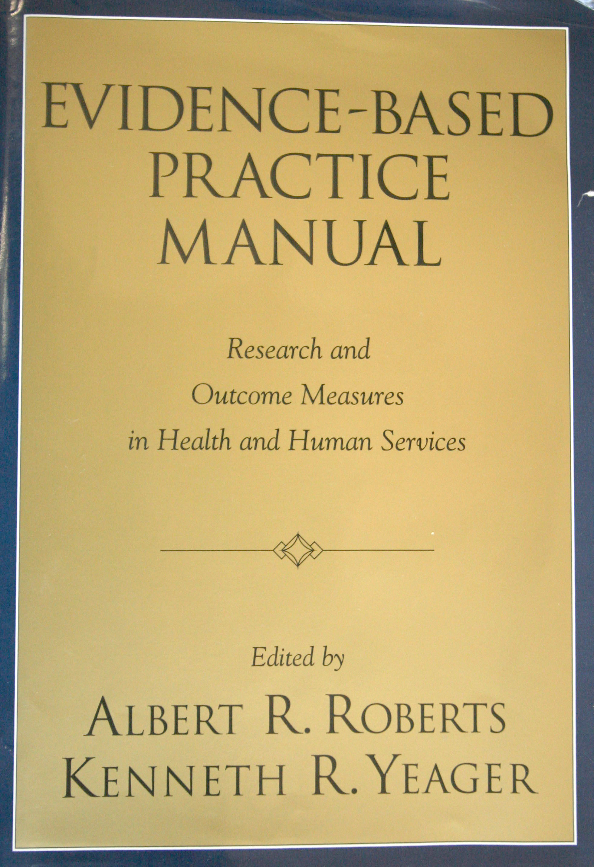
Evidence-Based Social Work
“Professional judgments and behaviors should be guided by two interdependent principals:
Whenever possible, practice should be grounded on prior findings that demonstrate empirically…that they are likely to produce predictable, beneficial, and effective results.
Every clients system, over time should be evaluated”
Evidence Based Practice Manual
Oxford University Press
2004
Albert Roberts, PhD
Kenneth Yeager, PhD, LISW

Slide 4
Reasons for Resistance to EBP’s
Poor connection between research and practice
Segregation of researchers and clinicians, and research and practice classes in primary training programs.
Some researchers can’t seem to say anything works or apply it to the real world.
Research findings often appear overly complex to the point of seeming to be useless or not applicable to many clients.
Not enough outcome research with commonly used interventions.
Little effectiveness research.
No or ineffective dissemination efforts by developers of EBP’s.
Inadequate continuing education system.
Lack of demand for EBP’s by consumers of services

Slide 5
Challenges Facing Accountability
Evidence-of-effectiveness is unknown
Authority is poorly established
Conflicting hierarchy
Definition of evidence lacks consensus
Shortage of evidence
Variation by field of practice
Inflation of evidence
Small & transient effects
Assessment validity
Efficacy versus effectiveness
Diffusion, adoption and implementation
Policy & system level issues
Training & sustaining is lacking or non-existent

Slide 6
Elements of Successful Practice
Committed to client’s best welfare
Values-guided
Goal-directed, hence pragmatic
Accountable: Must demonstrate effectiveness and efficiency
Committed to science-based criteria for evidence and knowledge

Slide 7
Accountable Practice Must Be:
Responsive to client needs and concerns
Outcome oriented
Systematic
Explicit and subject to scrutiny
Guided by scientifically tested knowledge on effectiveness
Evaluated and corrected

Slide 8
Accountable Practice Guidelines
Assembly and organization of empirically tested knowledge to inform effective practice
Facilitate practitioners’ access to, use, and proper application of that knowledge to the individual case
Maintain communication between practitioners and researchers regarding knowledge needs
Enhance practice-relevant research and capitalize on practice-generated clinical hypotheses and innovations

Slide 9
Measuring the “Value” of Social Work
Measurement of the “increment” attributable to social work intervention
Quantification of value
Cost to deliver
Cost-benefit
Cost of care studies
Comparative costs of interventions
Studies of value, or cost-effectiveness, cost-benefit

Slide 10
Key Research Questions to Ask
What interventions are effective?
What interventions are effective for a priority outcome?
Which interventions are most effective for a given outcome?
What interventions correspond to client preferences?
Which interventions are most effective for the client group at hand?
What interventions are most cost-effective?

Slide 11
Managing Agency Fiscal Distress
In many respects, the rapid, unmanaged growth of nonprofits and social services in recent decades has produced an age of financial uncertainty. Few sources of stable income, combined with cutbacks of a variety of state and federal support programs, cost control efforts in health care, various machinations of accountability, the consistent failure of many funding sources to acknowledge need for long term operating support (on the theory that “risk is good discipline”), managed care and many, many other factors have made this a period of great financial uncertainty for many entities and program managers.
Conceptually, fiscal distress is unfortunately often almost a normal operating condition for many organizations,. For such organizations.
Accountable practices to document services, and the costs and benefits that accrue from them, are essential to sustainability.

Slide 12
Financial Vulnerability
Financial vulnerability can be thought of as when the normal uncertainties and challenges of operating rise to the point that they begin to pose real threats to the continued viability of effective management decision-making and the continued delivery of programs and services.
Acute financial vulnerability often requires some type of evasive action to avert disaster:
The organization may reach a point where there is no ‘margin of comfort or safety’
It may become necessary to cut or eliminate services
Acute financial vulnerability may persist for long periods of time and become chronic. e.g., One of the measures used in the research is multiple years of net losses.
In extreme cases, swift action may be required to avert bankruptcy.
Risk of bankruptcy is a conventional measure used in the business research and some of the nonprofit research on financial vulnerability.

Slide 13
Public Expenditures Evaluation
Comprehensiveness
-- includes all revenue and expenditures for all programs
Accuracy
-- records actual transactions and flows, and maintains documentation
Annuality
-- cover a defined period of time (e.g. one year budget, multi-year forecasts)
Authoritativeness
-- only spends as authorized by law and policy
Transparency
-- information on spending is public, timely, understandable
Audits and Reports
-- conducted by independent auditors

Slide 14
Ideologies and Politics in Research
• politics play a role at several levels including what to research, how to measure results, and how to use findings.
• researchers must be mindful of political barriers to research in terms of gaining access to information and getting administrative approval.
• approaches to social work practice have many political dimensions including management oversight, budgets, and the role/involvement of employees and clients.
• researchers must be aware of policy directives and advocacy for changes in policy and resource allocation.

Slide 15
Dilemmas in Reporting Findings
• are the findings published or presented privately?
• who is provided with the report – director, board, staff?
• need to protect privacy and confidentiality of sources.
• consider the implications of findings.
• recommendations for changes and/or new directions.
• what to do with unexpected or conflicting results.
• how to address gaps or missing data in the research
• options for presenting findings – written & oral reports

Slide 16
Responsibility and Accountability
Includes responsibilities to:
• stakeholders
• sponsors and funders
• profession
Future Directions – Next Semester
Happy Holidays!!

