Slide 1
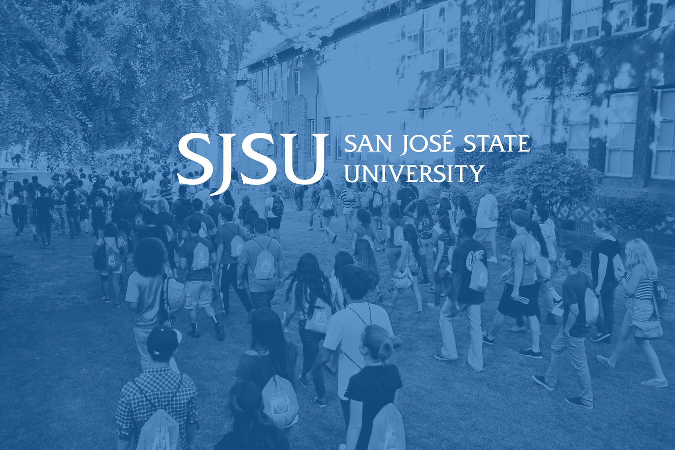
Campus Climate Survey 2015
Preview of Findings
December 7, 2015
John Briggs
Meg Virick
Scott Heil

Slide 2

SJSU Washington Square
Roadmap
  Goals and Purpose
  Description of the Study
  Survey Methodology
  Topic Areas Covered
  Preview of Findings
  Selected Results by Topic
  General Climate
  Experiences of Discrimination
  Open and Respectful Communication
  Social Engagement and Activities
  Personal Safety
  Job Satisfaction
  Governance and Campus Leadership
  Concluding Thoughts

Slide 3
SJSU Washington Square
Goals and Purpose
Purpose:
This survey, very similar to the campus climate surveys conducted in 2006 and 2010, sought to better understand the experiences of the campus community. It also coincided with the intent of the President’s Commission on Diversity (PCD) to understand campus climate.
Goals:
Identify campus climate concerns affecting students, faculty, staff, and administrators.
Compare campus climate data from a previous survey done in 2010.
Help prioritize and target university actions to improve the campus climate

Slide 4
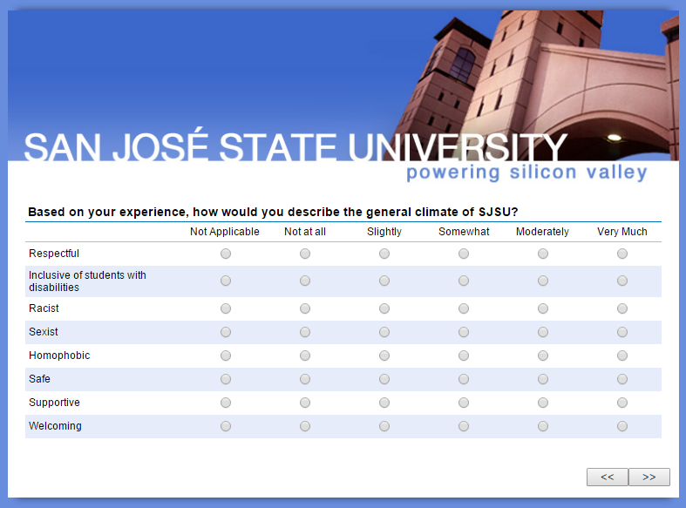
SJSU Washington Square
Survey Methodology
  All current students, faculty, staff, and administrators were invited via e-mail to complete the survey online in March and April 2015. Responses were anonymous, but those who provided their contact information were eligible to win a gift card for their participation.
 | Total Population Contacted | Usable Responses Received | Estimated Participation Rate
Students | 33,659 | 5,586 | 17%
Faculty (incl. temporary) | 2,320 | 493 | 21%
Staff & administration | 5,329 | 783 | 15%

Slide 5
Respondent Profile: Students
Gender
55% Female, 44% Male, 1% (Genderqueer, Transman, Transwoman, Intersex,Other)
Age
Average age was 24. About 25% were younger than 20 years of age
Disability
6% indicated having a disability
Ethnicity
Asians (41%) were the predominant ethnic group, followed by White (24%), Latino (19%), Two or more races (7%), African American (3%), Middle Eastern (2%), Pacific Islander (1%) and others (4%). The predominant Asian nationalities were Asian Indian (27%), Chinese (25%), Vietnamese (19%), and Filipina/o (12%)
Notes:
Gender: 4,666 students responded Female 2,527 (55%), Male 2,036 (44%)
>1%: Genderqueer 24, Other 17, Transman 8, Transwoman 6, Intersex 3
Age: 4,669 students responded Minimum <20 (1143, 25%); Maximum >50 (113, 2%); Average (Wghtd) 24 years of age
Ethnicity: 4,690 students responded
Disabled: 4,717 students responded Not disabled 4,438 (94%), Disabled 279 (6%)

Slide 6
Respondent Profile: Students
CLASS LEVEL
ADMISSION TYPE
Sample size: 4,681
Sample size: 4,685
The majority of the responses came from juniors (26%) and seniors (28%). Seniors were underrepresented in the sample, while juniors and graduate students were overrepresented. A plurality (43%) entered SJSU as freshmen.
Notes:
4,681 responded to this question, 5,568 student responded to survey

Slide 7
SJSU Washington Square
TIME SPENT ON CAMPUS
COMMUTE TIME
The largest share of respondents (35%) spent more than 10 hours a week on campus, 74% had a commute time of 30 minutes or less (includes 14% on-campus students)

Slide 8
Respondent Profile: Students
POLITICAL AFFILIATION
RELIGIOUS AFFILIATION
Other Religions: 401 Catholic, 120 None, 40 Sikh
Most students identify as being Democrats or have no political affiliation. In terms of religious affiliation, most are Christians followed by agnostics and atheists.

Slide 9
Respondent Profile: Employees
Gender
63% Female, 35% Male, 2% were Genderqueer, Transman, Intersex and Other
Age
Average age was 47. 20% were over the age of 60
Disability
9% indicated having a disability
Ethnicity
Most were White (44%), followed by Asians (18%) , and Hispanic/Latino (16%), Two or more races (7%), African American (5%), Pacific Islander (1%), and Other (5%)
Notes:
Race: Total Employees responded 1,063
Gender: Total responses (1,086); Male 381 (35%), Female 684 (63%
<1%: Other (11), Genderqueer (8), Transman (1), Intersex (1)
Disabled: Total Responses (1,096); Disabled (96, 9%), Not-disabled (1,000, 91%)
Age: Total respondents 1,025; Minimum 23 or younger (36, 4%), Maximum 60 or older (205, 20%), Wgnted Average 47 years
Sexual Orientation: Total responses (556); Heterosexual (457, 82%), Gay (23, 4%), Bisexual (21, 4%), Lesbian (19, 3%), Queer (11, 2%), Pansexual (3, <1%), Other (22, 4%)

Slide 10
Respondent Profile: Employees
COLLEGE OR ADMINISTRATIVE UNIT
Notes:
Category Total Employees Responded 1,276
Unit/College Total Employees Responded 1,088

Slide 11
SJSU Washington Square
Topic Areas Covered
 | Students | Faculty | Staff | MPP
General climate at SJSU
Immediate work climate
Success of diversity initiatives
Harassment/discrimination
Classroom/out-of-classroom experience
Perceptions of open communication
Participation in diversity activities
Diversity sensitivity
Job satisfaction & career issues
Governance issues
Demographics

Slide 12
SJSU Washington Square
Preview of Findings
The majority of students, faculty, staff, and administrators view the campus climate favorably
Nonetheless there are frequent concerns about several issues, notably
    Experiences of discrimination, intolerance, and hostility
    Lack of open, respectful communication, especially on sensitive topics
    Opportunities for deeper social engagement and on-campus activities
    Physical safety, particularly among students
    The style and direction of campus leadership
Where comparable data were collected, there are very few areas where perceptions of climate have measurably improved since 2010

Slide 13
SJSU Washington Square
General
climate

Slide 14
SJSU Washington Square
Most Stakeholders Upbeat, But Room to Improve
A majority of respondents in each constituent group—students, faculty, staff, and administrators—view most aspects of the overall campus climate favorably
Most perceived the climate as ‘moderately’ or ‘very much’ respectful (71% of students, and 67% of employees)
Most also viewed the campus as ‘not at all’ or ‘slightly’ racist (73% of students and 64% of employees). They also viewed the climate as less sexist (77% of students and 65% of employees)
African Americans were more likely to perceive the climate as more racist.
LGBT students were more likely than their heterosexual peers to view the university climate as homophobic
Among those who identified as disabled 23% of disabled students and almost a third of disabled employees rated the SJSU climate as ‘not at all’ or only ‘slightly’ inclusive of the disabled

Slide 15
SJSU Washington Square
Ratings by students of the general campus climate

Slide 16
SJSU Washington Square
Ratings by all employees (faculty, staff, administrators) of the general campus climate

Slide 17
SJSU Washington Square
Experiences
of discrimination
on campus

Slide 18
SJSU Washington Square
Many Students Experience Discrimination
Just over half of student respondents indicated one or more episodes of discrimination or harassment on campus. This proportion is unchanged from 2010
Race, Gender, and Political Views are the most commonly cited forms of discrimination or harassment
African American reported experiencing more race-based harassment than other groups and women were much more likely to report gender discrimination
Most often, other students are the source of discrimination
Students in 2015 were less likely to feel that SJSU staff were sensitive to issues of sexism, racism, and homophobism than in 2010

Slide 19
SJSU Washington Square
Student reports of discrimination or harassment by type and source
Who committed the act of discrimination or harassment?
Type of
discrimination
reported
For example, in the Figure above, 10.2% of the reported incidents – 805 separate responses indicated an episode of race discrimination caused by a student

Slide 20
SJSU Washington Square
Faculty and Staff Report Many Instances, Too
Gender, age, and ethnic discrimination are the most commonly cited forms of discrimination or harassment among employees
In-group discrimination was the most prevalent for faculty, staff, and administrators
The most prevalent discrimination instances by type of discrimination and source include:
    Faculty: Gender (by other faculty and by administrators)
    Administrators: Gender & Age* (both by fellow administrators)
    Staff: Race (by other staff) & Age* (by administrators)
* Age discrimination was prevalent in both younger and older employees

Slide 21
SJSU Washington Square
Faculty/staff/administration reports of discrimination or harassment by type and source
Who committed the act of discrimination or harassment?
Type of
discrimination
reported

Slide 22
SJSU Washington Square
Open and
respectful
communication

Slide 23
SJSU Washington Square
Both Students and Employees Worry About Voicing Unpopular Opinions
Part of the university community feels marginalized due to few venues for free, civil discussions and even overtly hostile encounters that discourage open exchange of ideas
This can include sensitive issues like past hate crimes, race, and the airing of other problems on campus
In general, as compared to students, employees are much more critical of the university not being successful at facilitating differences of opinions

Slide 24
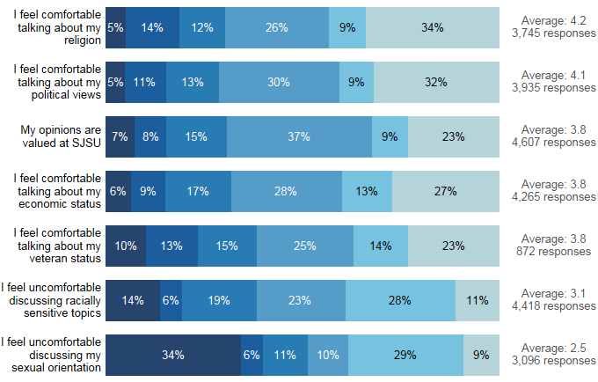
SJSU Washington Square
Ratings by students on perceptions of open communication

Slide 25
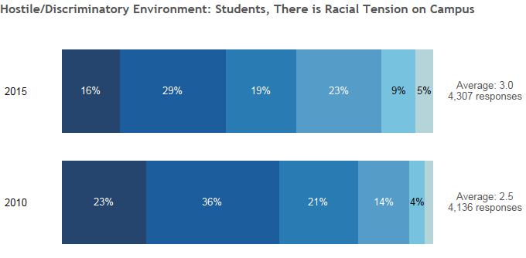
SJSU Washington Square
Ratings by students on perceptions of racial tension on campus

Slide 26
SJSU Washington Square
Ratings by faculty, staff, and administrators on perceptions of open communication

Slide 27
SJSU Washington Square
Social engagement
and campus activities

Slide 28
SJSU Washington Square
Students and Employees Seek Deeper Interaction, More Events
Students living both on and off campus expressed interest in having more activities—including many ideas about clubs—as well as better notifications about upcoming events, including via e-mail and Canvas
Faculty and staff described similar concerns about lack of community and a wish for more social events
African Americans were less likely to believe that SJSU was building a sense of community

Slide 29
SJSU Washington Square
Personal
safety

Slide 30
SJSU Washington Square
Students Increasingly Concerned About Safety
More than 300 written comments referred to matters of physical safety on campus, with women and minorities more likely to have fears
The percentage expressing fear rose substantially from 2010 to 2015
Females and nontraditional gender students were more likely than men to express concerns about safety
Asian students were also significantly more likely than either whites or Latina/os to express concerns about safety

Slide 31
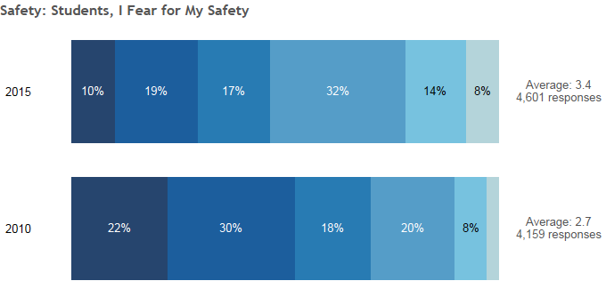
SJSU Washington Square
Ratings by students on whether they fear for their safety on campus
Average: 3.6
4,601 responses

Slide 32
SJSU Washington Square
Job
satisfaction

Slide 33
SJSU Washington Square
Faculty Morale Low, Staff Seek Recognition
Faculty had concerns about decision-making, sharing of information, and opportunities for research and professional development, while staff and administrators sought more mentoring and recognition
Both faculty and administrator overall job satisfaction declined from 2010 to 2015, and compensation was cited often by faculty and staff
African American employees reported having greater satisfaction with their level of autonomy and overall job satisfaction, and rated their professional relationship with coworkers higher.

Slide 34
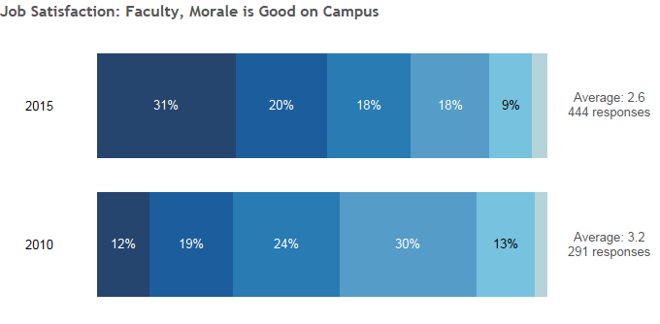
SJSU Washington Square
Ratings by faculty on whether they believe faculty morale is good

Slide 35
SJSU Washington Square
Governance
and campus
leadership

Slide 36
SJSU Washington Square
Dissatisfaction with Campus Leadership
Satisfaction with campus leadership dropped precipitously from 2010 to 2015 among faculty, staff, and administrators
The largest decrease among administrators and the smallest among staff.
Many respondents perceived a lack of transparency, disconnected decision-making, and a decline of shared governance

Slide 37
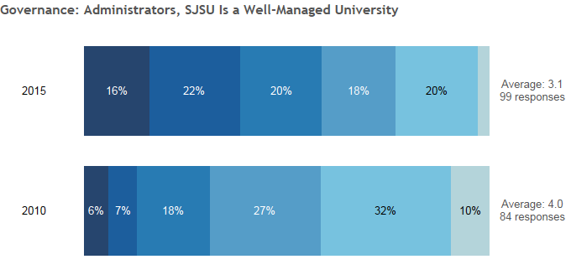
SJSU Washington Square
Ratings by administrators on whether they believe SJSU is a well-run university

Slide 38
SJSU Washington Square
Concluding Thoughts
The survey highlighted the importance of the following issues:
Safety in particular for students on campus after dark
Civility, respectful discourse, and constructive social engagement among students
Structured, supportive venues for open discourse on topics of concern, including controversial subjects
Sensitivity/awareness training for the whole campus community
Accessible campus leadership

Slide 39

Discussion

